Slide 1
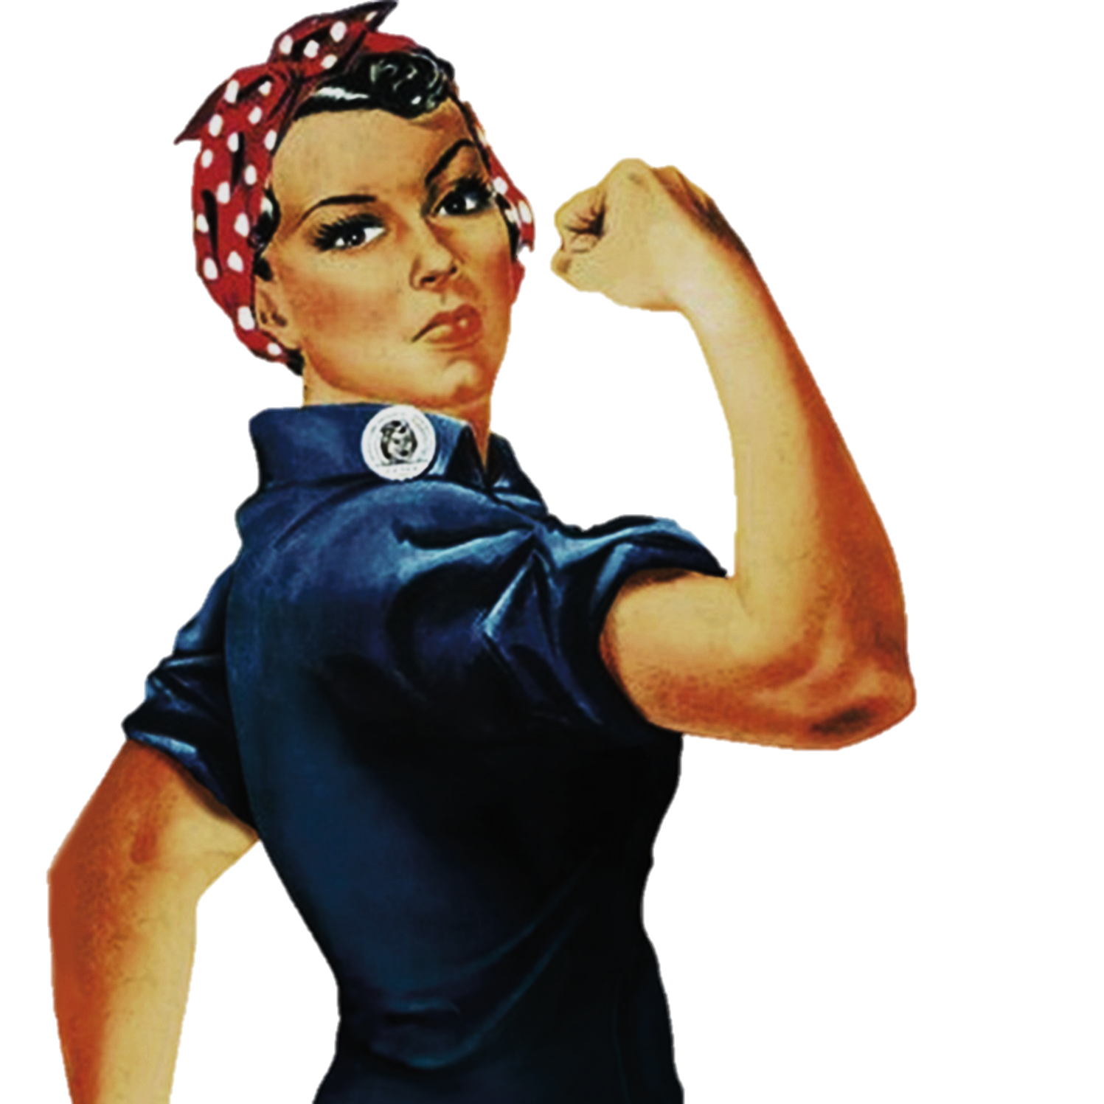
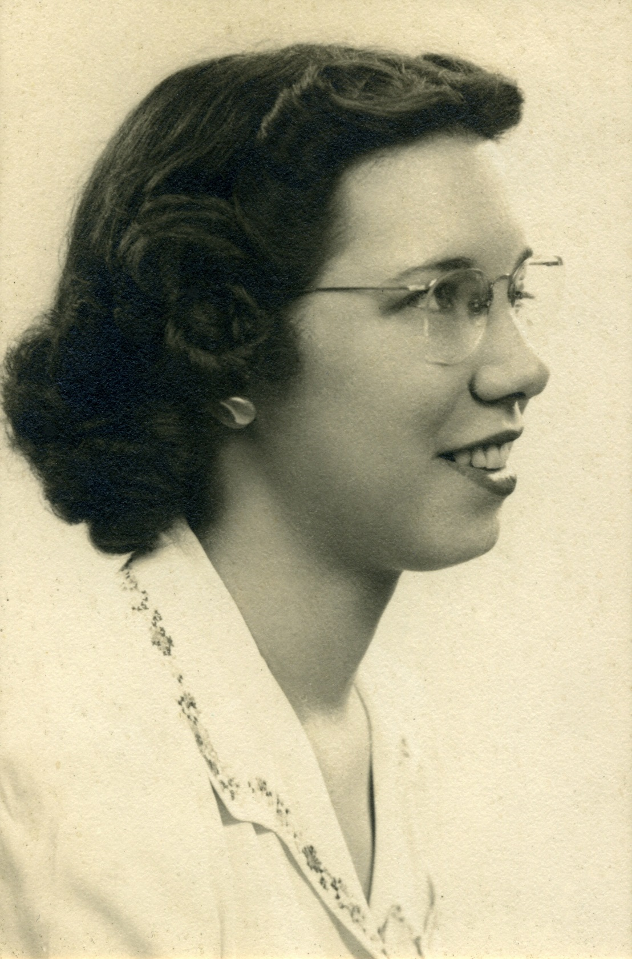



Women
Betty Holberton
To change pictures:
Save the picture of the person you wish to use.
Single-left-click the grouped picture/shapes you wish to change on the poster. Single-left-click again on the picture.
Now single-right-click the picture and select “Change Picture” from the menu.
Choose the picture file you saved.
You may wish to single-left-click the grouped picture/shapes and single-left-click the new picture again to adjust its size or crop it—especially useful if the new picture is not the same aspect ratio as the previous one.
DO NOT CHANGE ROSIE THE RIVETER PICTURE!!!
In Technology
1945 Selected as first programmer for all-electronic digital computer, ENIAC.
1957 FORTRAN development
1959 Chief programming research branch for the Applied Mathematics Laboratory & wrote first generative programming system
In 1945, the U.S. Army recruited six women working as computers at the University of Pennsylvania to work full-time on a secret government project. For the next year, they used their creativity, tenacity and solid backgrounds in mathematics to become the original programmers of the world's first electronic general-purpose computer, called ENIAC.
“They stepped in to do a job that they didn't understand, that nobody understood. So they had to invent, discover, and learn how to work this machine without any real training. In that sense, they were real trailblazers.” – Bill Mauchly of Berwyn, son of one of the original six programmers
What paths will you trailblaze that no one has traveled before?

